Slide 1
iHRIS
iHRIS is simple, easy-to-use, open source software that supplies health-sector leaders with information to track, manage, and plan the health workforce.
iHRIS helps countries in low-resource settings capture high-quality data on health worker numbers, skills, qualifications, locations, and more.
With this information, nations can address health workforce shortages and solve other challenges across the health sector and beyond.

Slide 2
currently offer three comprehensive solutions for managing health workforce information.
iHRIS Manage is a human resources management system for ministries of health and other service delivery organizations.
iHRIS Qualify is a health licensure and certification database for professional health councils.
iHRIS Train is a tool for managing health worker training information

Slide 3
iHRIS Manage
iHRIS Manage enables an organization to design and manage a comprehensive human resources strategy.
It typically resides with an employer of health workers, such as a Ministry of Health or a health facility.
It tracks detailed information about health workers throughout their employment, including where they are deployed, salary history, promotions and transfers, qualifications, in-service training courses, and reasons for attrition.
iHRIS Manage also tracks open positions and applicants.

Slide 4
iHRIS Qualify
iHRIS Qualify enables a licensing or certification authority, such as a nursing council, to track complete data on a health worker cadre from pre-service training through attrition.
It captures information about health professionals in that cadre from the time they enter pre-service training through registration, certification, and/or licensure.
iHRIS Qualify can also track employment, continuing education credits, and out-migration requests for workers in the cadre.

Slide 5
iHRIS Train
iHRIS Train was developed by teams in Uganda and Kenya to facilitate the management of health worker training programs.
It provides a comprehensive view of health worker education, from preservice education at universities or training institutions through regular in-service training.

Slide 6
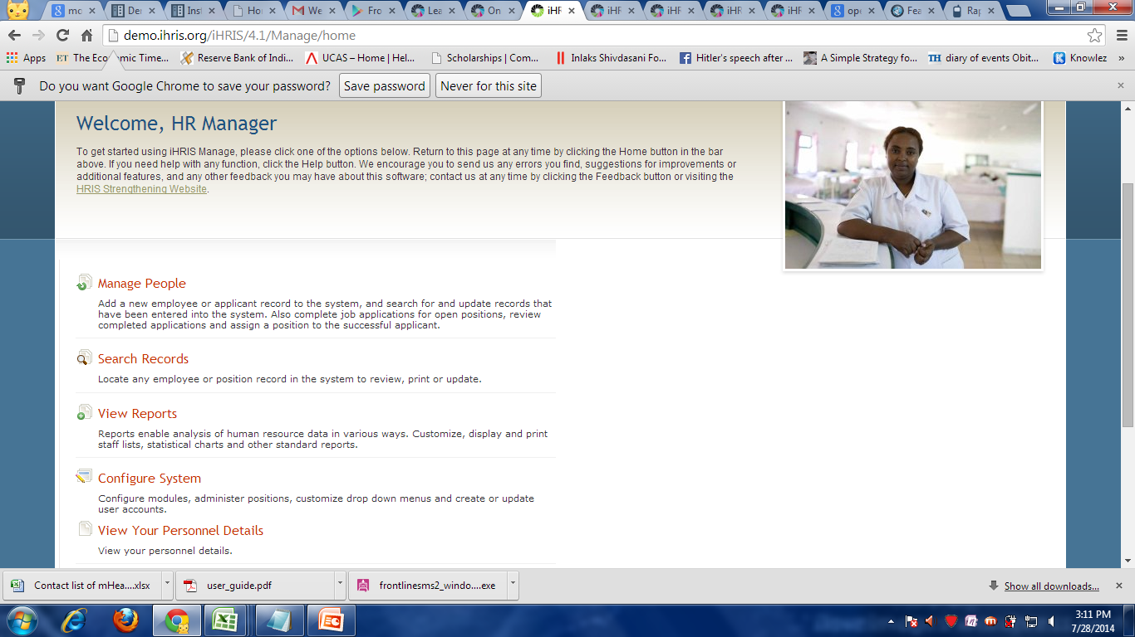
iHRIS Manage Demo

Slide 7
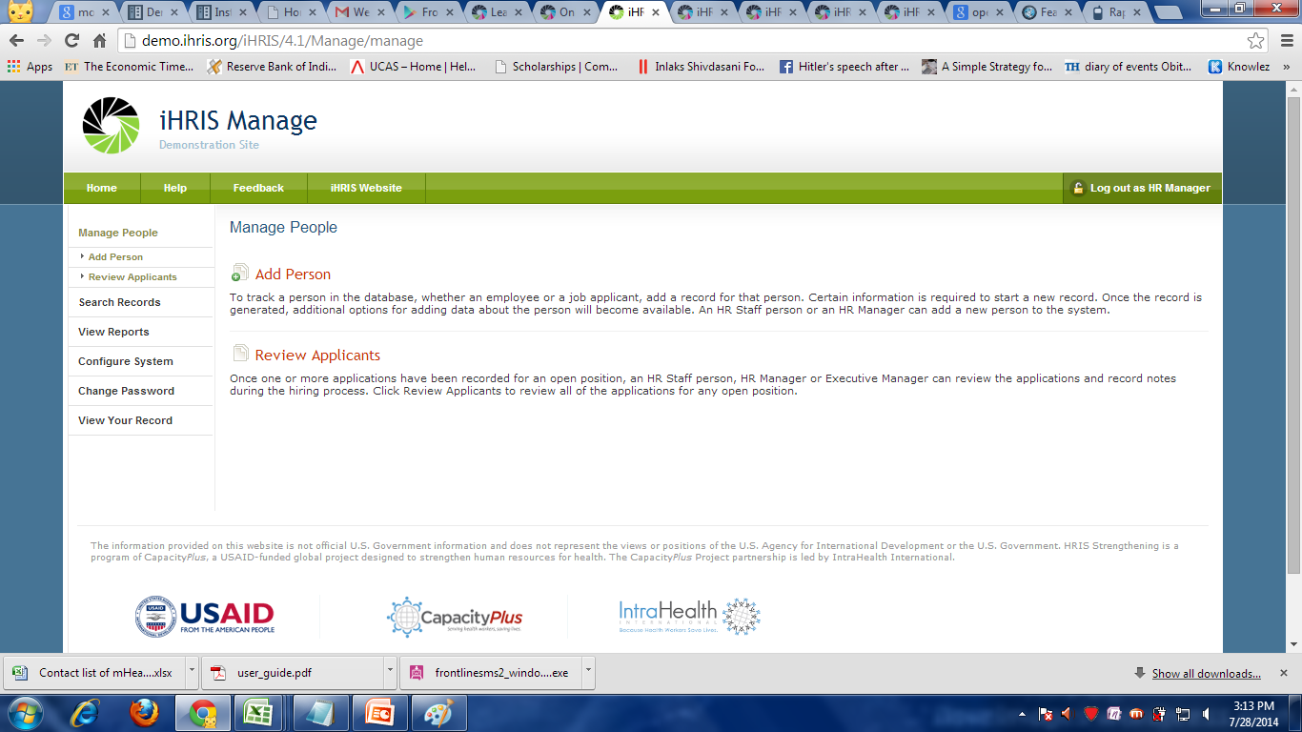
ADD EMPLOYEE’S DETAILS

Slide 8
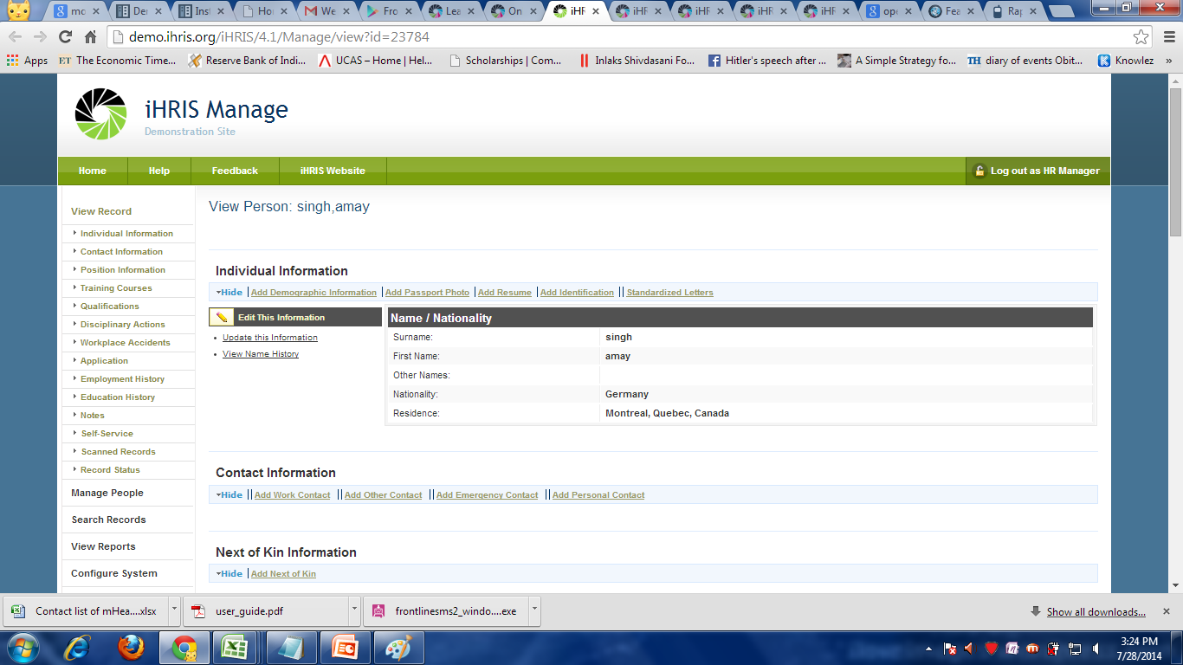
ADD RELEVANT INFORMATION

Slide 9

SEARCH FOR EMPLOYEE’S RECORD.

Slide 10
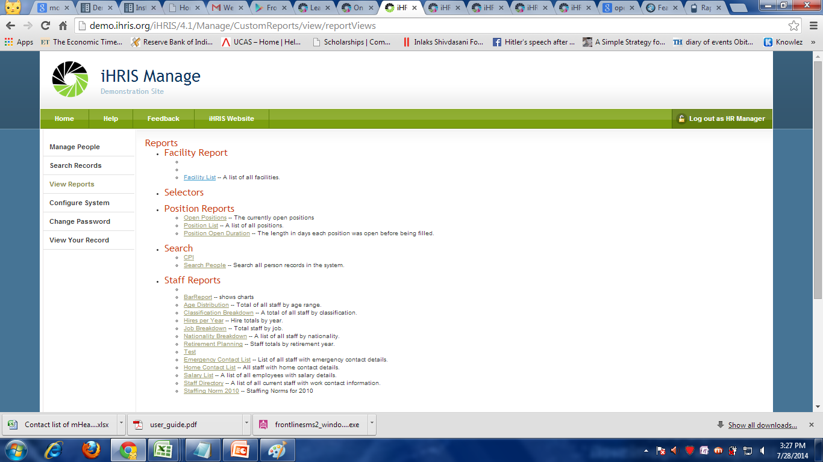
VIEW LIST OF EMPLOYEES WITH SUNDRY DETAILS REQUIREMENTS.

Slide 11
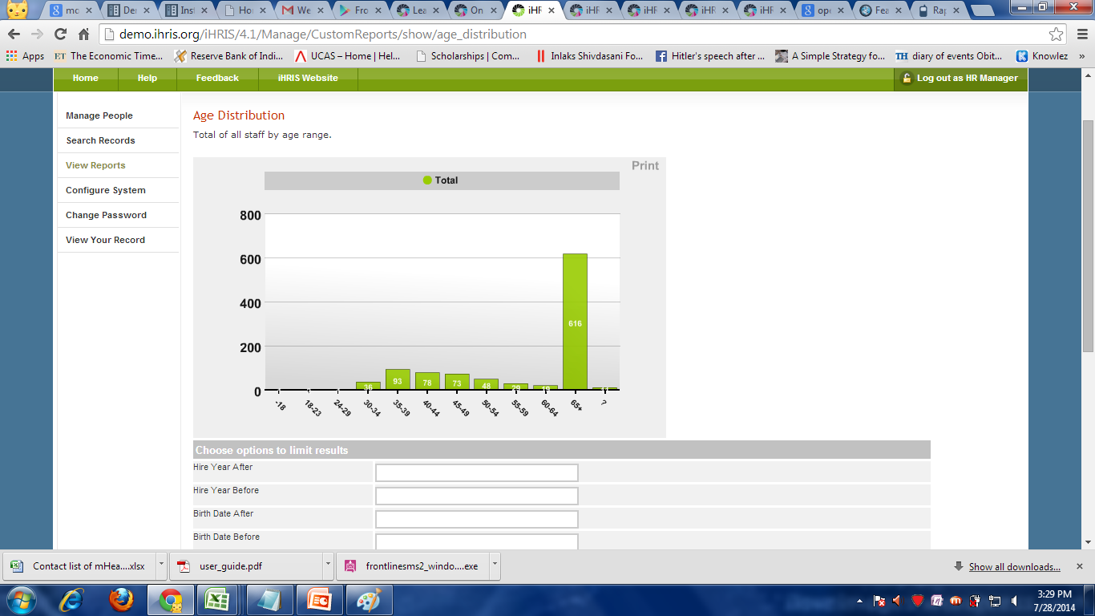

Slide 12

MAKE CHANGES IN DIFERENT FIELDS WHILE RECORDING EMPLOYEE’S INFORMATION AND MANAGE REPORTS TO CHANGES DIFFERENT SELECTION CRITERIA.

Slide 13
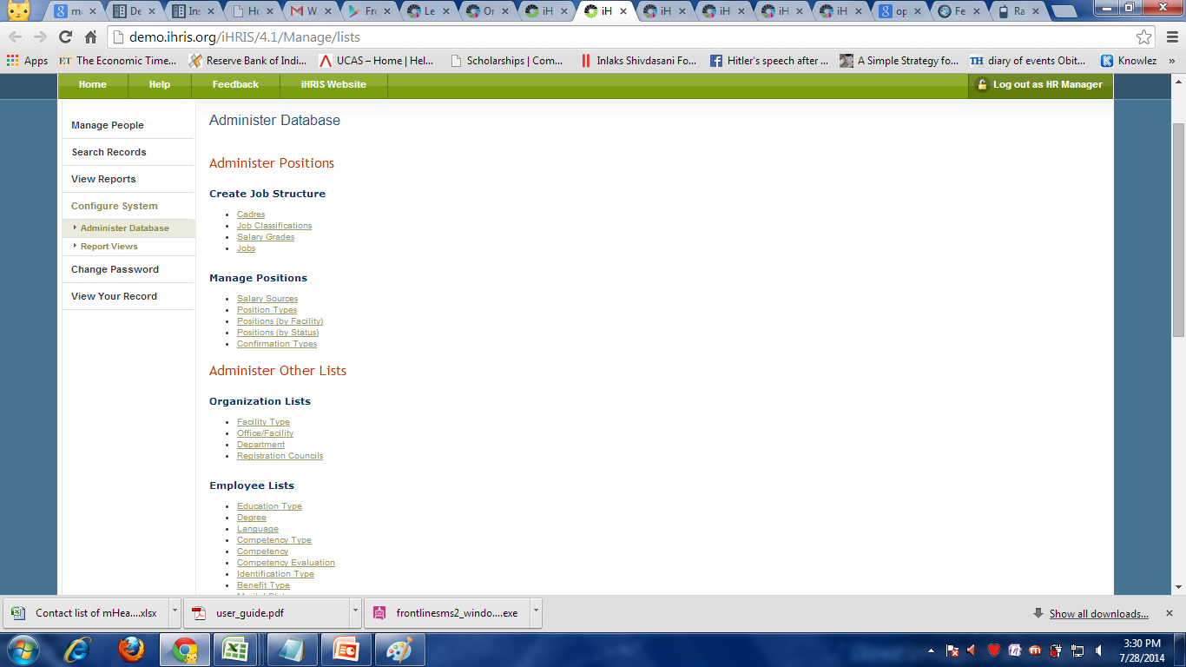
DATABASE

Slide 14
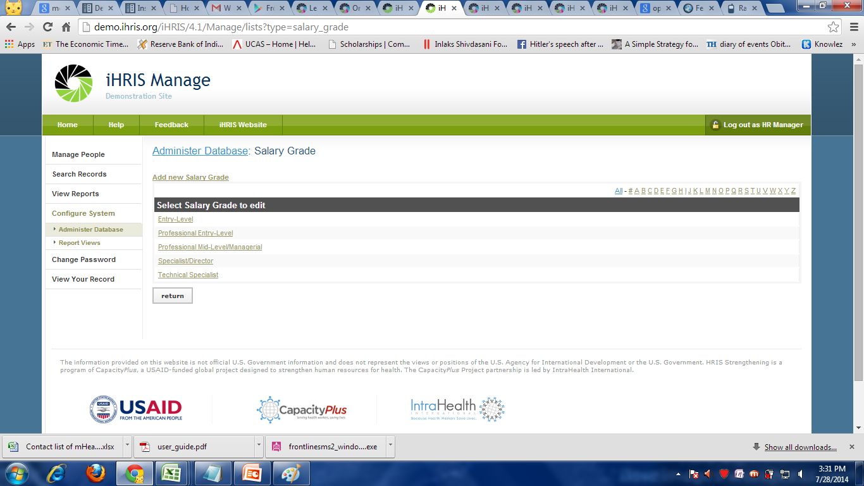

Slide 15
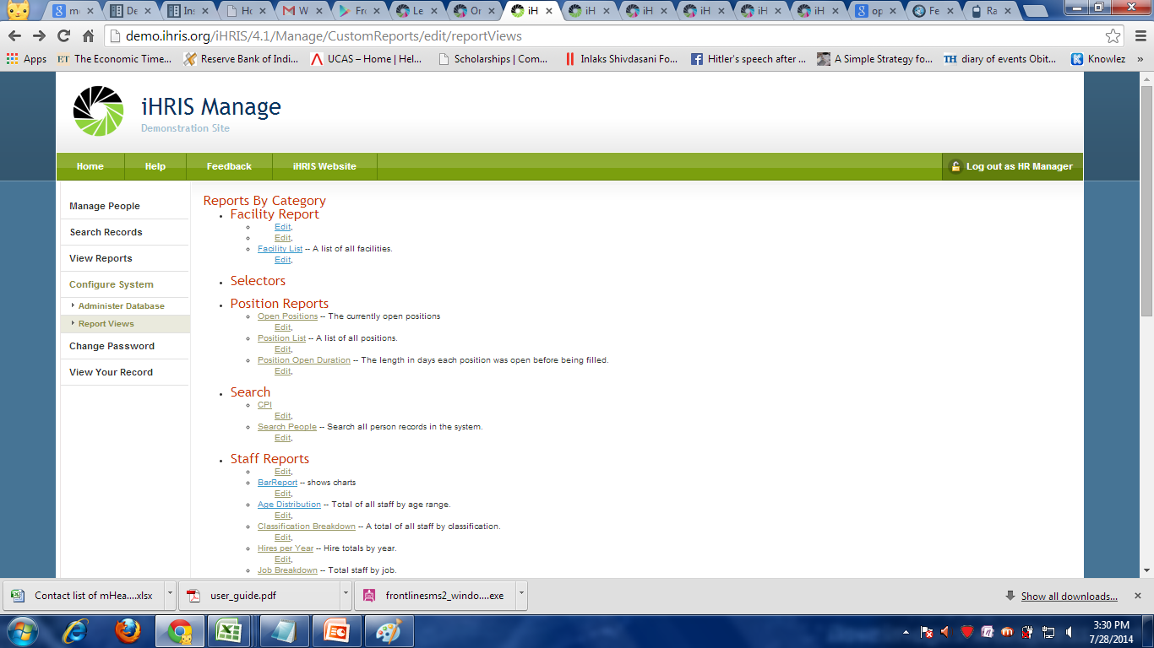
REPORTS
EDIT WHAT TO DISPLAY IN THE LIST

Slide 16
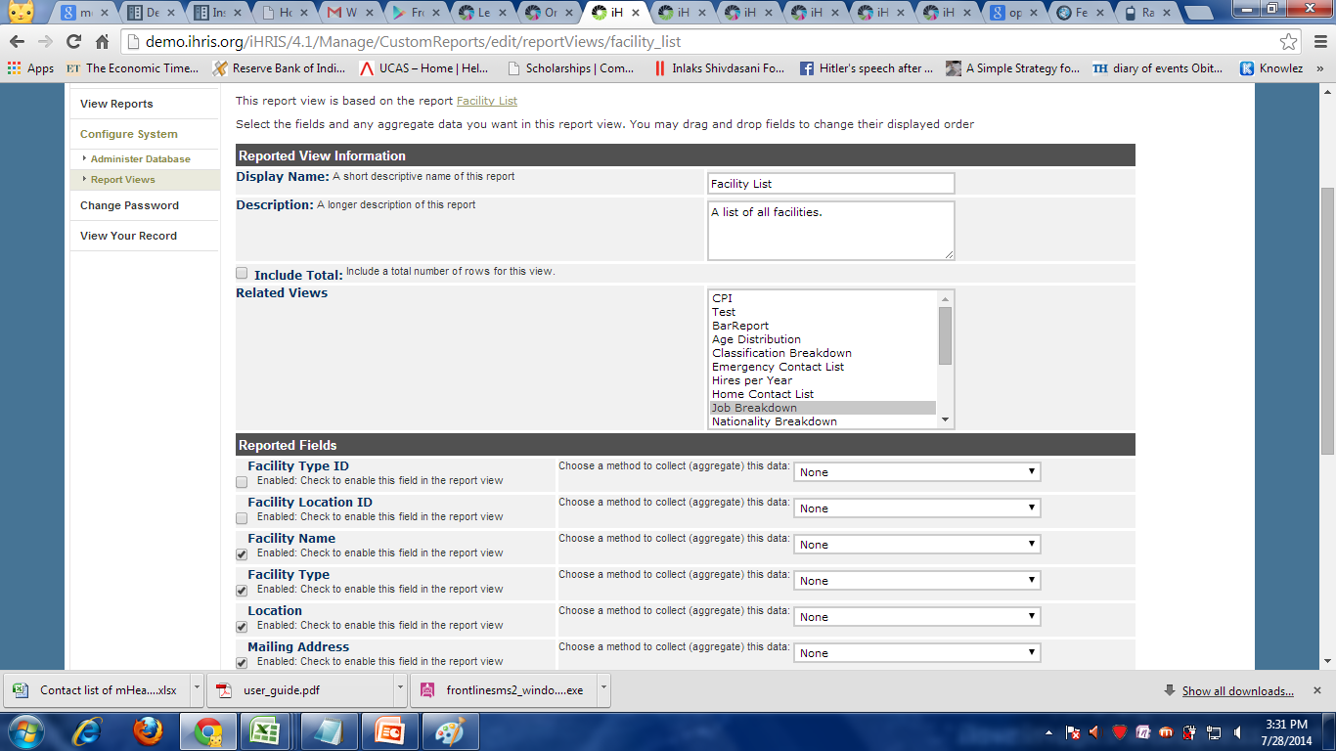

Slide 17
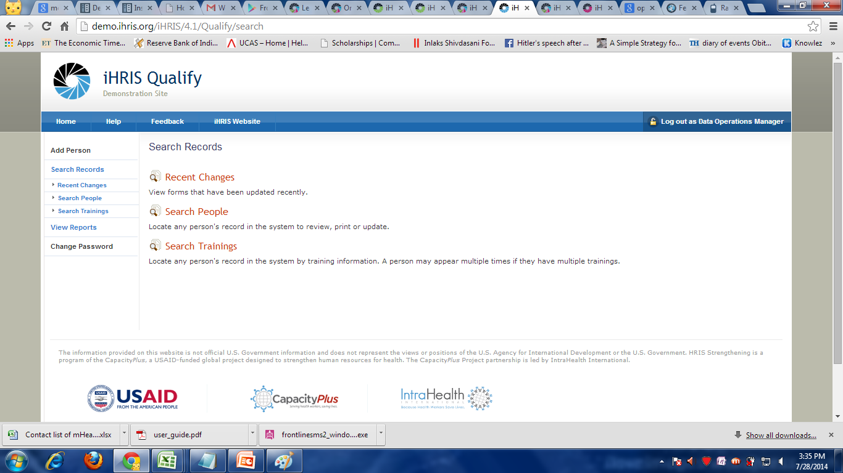
Similarly iHRIS Qualify

Slide 18
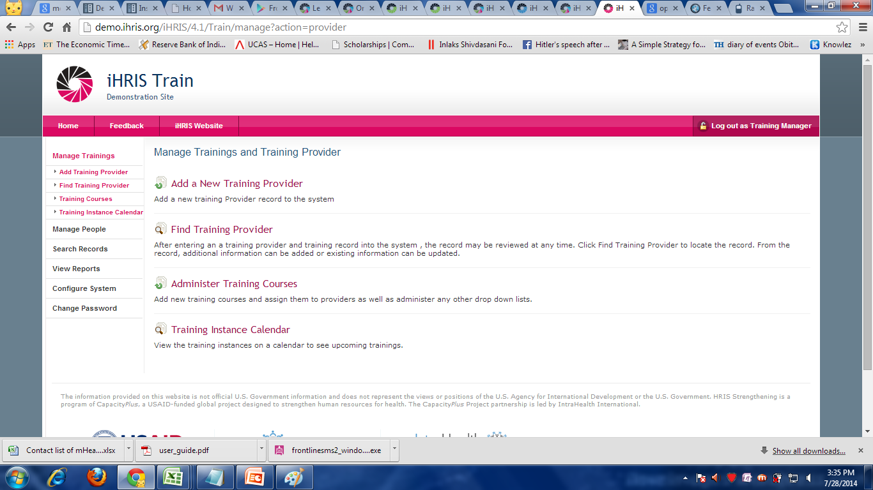
And iHRIS Train

